Slide 1
Easy Speech
Created by:
Pontus Olsson Martin Eriksson Jonas Karlsson

Slide 2
Topics
Introduction
Starting idea
The actual idea
Android
Bluetooth
SQLite database
Arduino
Leif v 0.1

Slide 3
The starting idea
A voice activated robot
Voice recognition in C
Robot recognizes different users
Gives a voice feedback depending on user

Slide 4
The actual idea
Voice controlled robot
Android(java) instead of C
No recognition for different users
No voice feedback from the robot

Slide 5
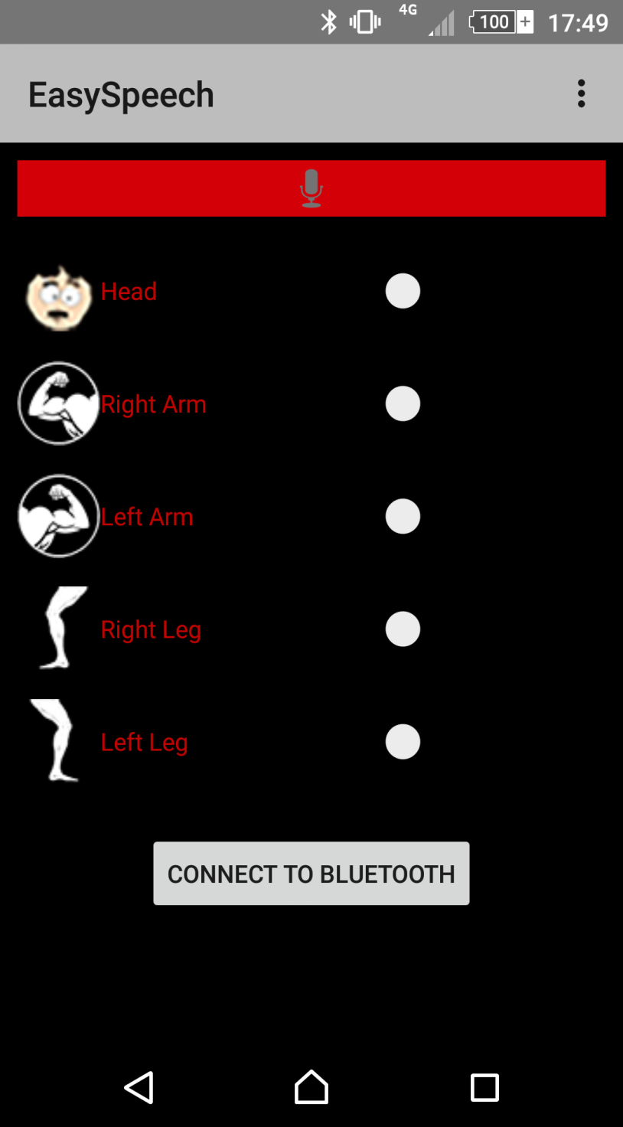
Android
This is the EasySpeech app

Slide 6
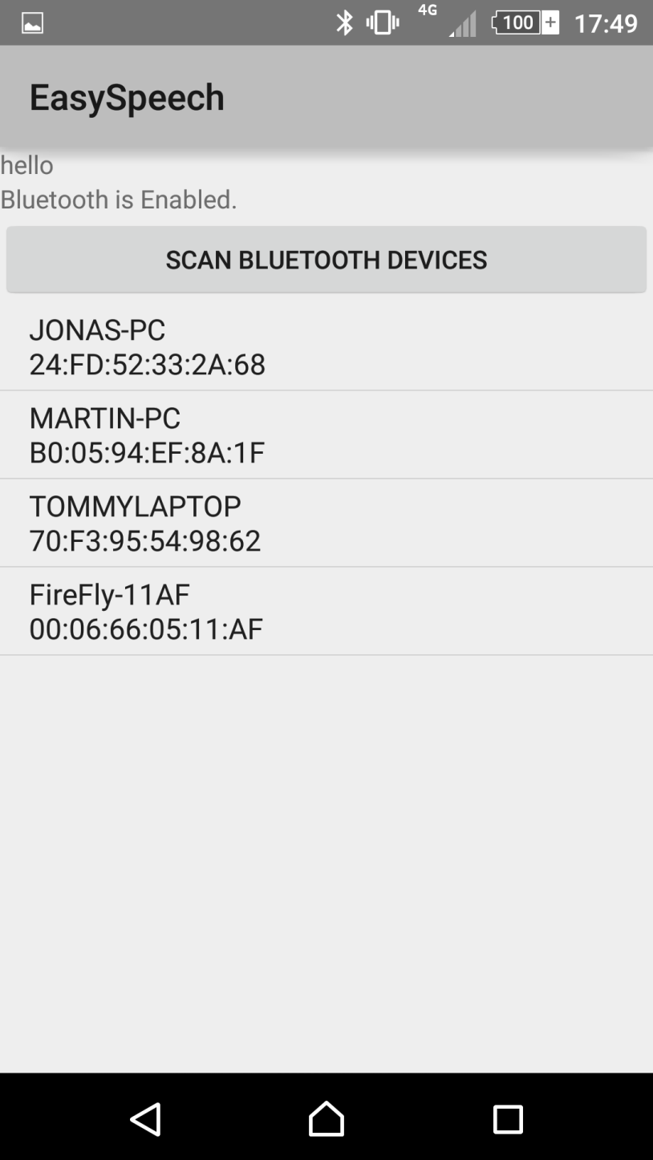
Bluetooth
Bluetooth devices
Our bluetooth module

Slide 7
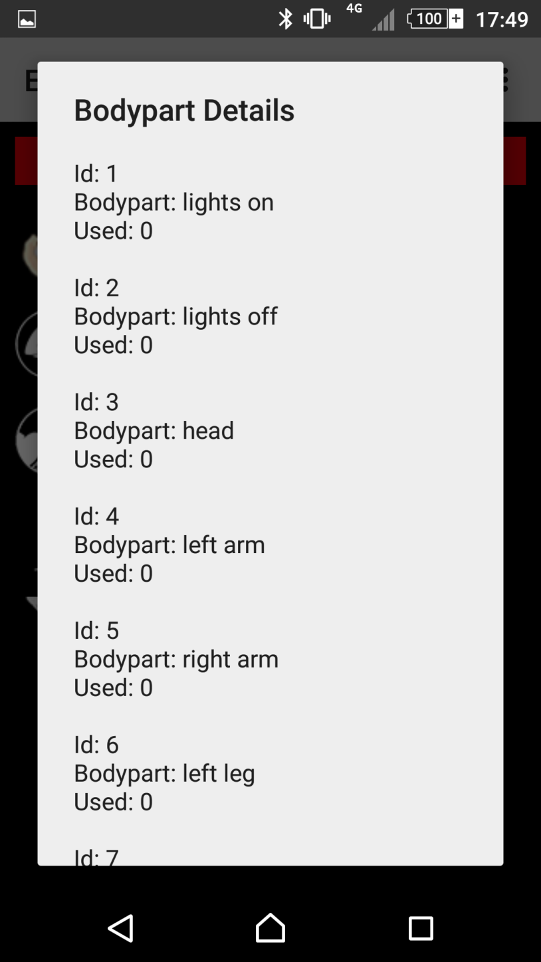
SQlite Database
This is the database containing the command history
Why?

Slide 8
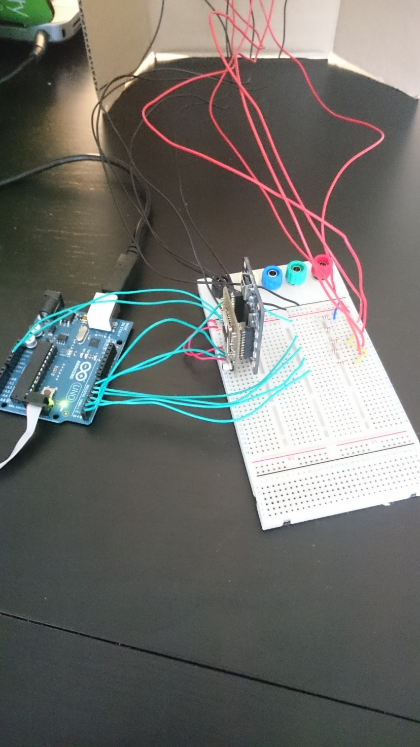
Arduino

Slide 9
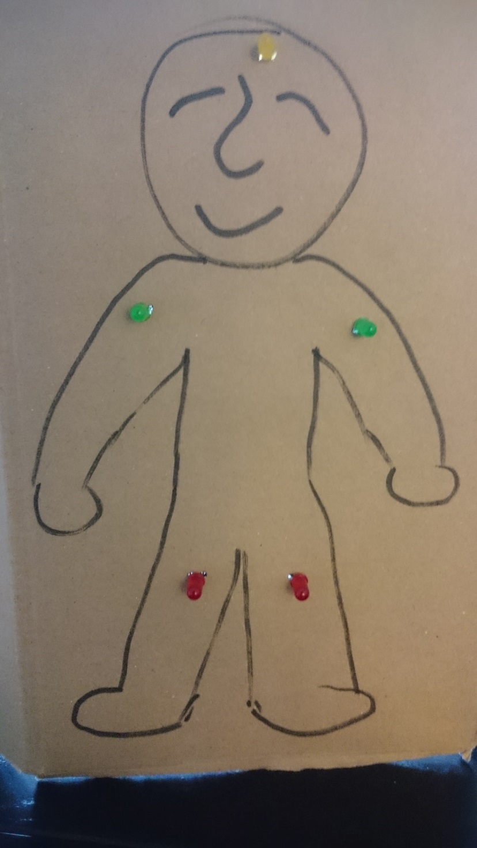
Leif v 0.1
This is Leif
He knows not much, but the lights on his limbs but happy he is anyway
The best thing he knows is hiding in the bushes and catch small children exept he sucks at it, they see him coming miles away.

